Slide 1
Testing Opensearch-py
By: Matthew Lake (2716928)

Slide 2
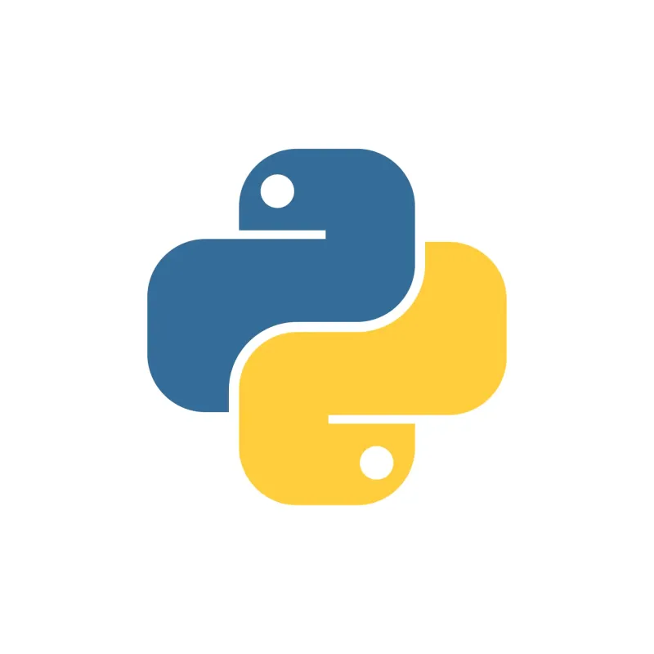

What is Opensearch-py?
A Python library is used for interacting with an OpenSearch cluster inside of a Python application
OpenSearch is a document-based NoSQL database
OpenSearch databases are mainly used for search via full text search and application log and data analysis
The major functions of the library are communicating and facilitating index setup and management, document creation and management, and searching for and aggregating documents

Slide 3
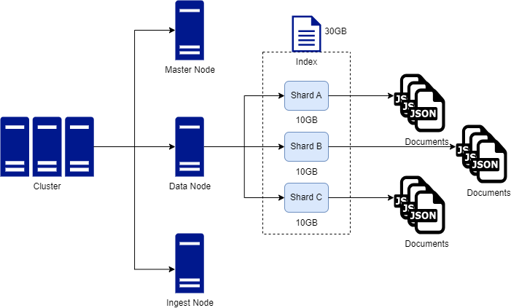
OpenSearch Cluster Architecture

Slide 4
Functionality Tested
Initializing an OpenSearch cluster client and using ping to verify connection
Creating/Modifying/Deleting/Reindexing a cluster index
Creating/Updating/Deleting cluster index aliases
Creating/Indexing/Bulk Indexing/Updating/Bulk Indexing/Retriving/Deleting Documents
Searching for Documents using Full Text, Term Level, Compound Boolean, and Geospatial query types
Aggregating Documents using Bucket and Metric(statistical) aggregation types

Slide 5
How was the Functionality Tested?
Setup a Python testing environment inside of a Docker container
Setup a test OpenSearch cluster to perform tests on using Opensearch-py and OpenSearch indirectly
Used Pytest fixtures to assist in setting up scenarios and test preparation
Created integration tests for testing each functionality’s happy path and the various other paths

Slide 6
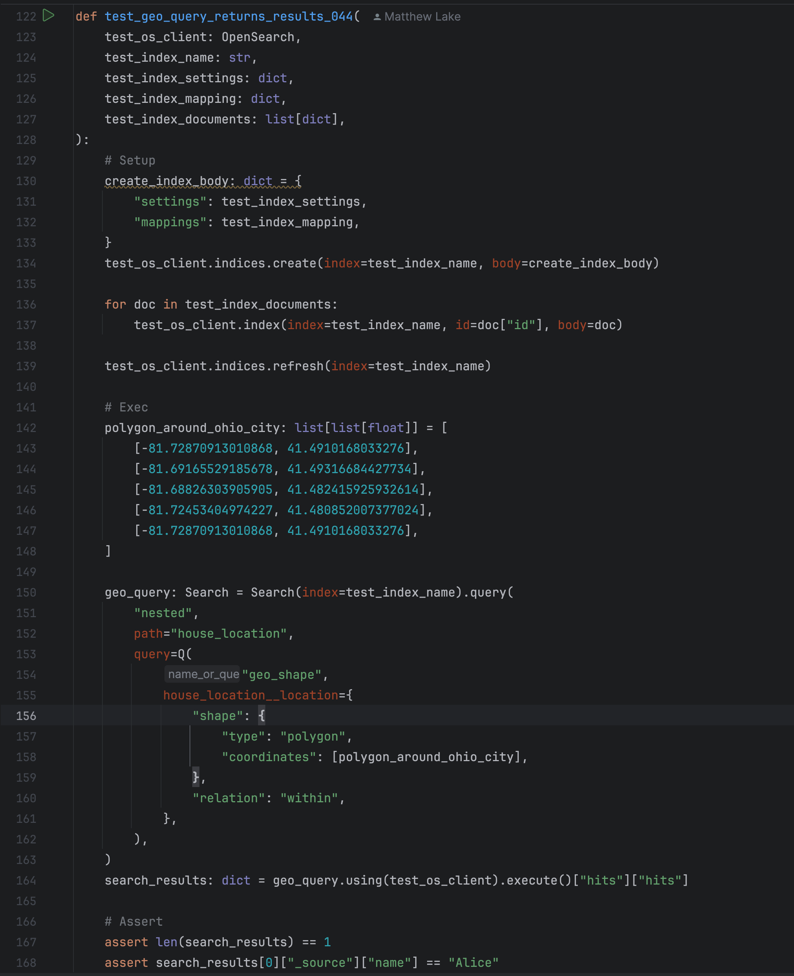




Test Case Structure

Slide 7
Bonus Activities
Setup Make commands to run the test suite automatically
Used the Poetry library for dependency management
Setup Python linter libraries to conduct linting checks over the repository
Setup a GitHub Action for running the test suite in a GitHub runner on pull request and merge

Slide 8
Testing Results
Ended up developing and executing 52 test cases
All of them passed

Slide 9
Live Demo/Walkthrough

